Slide 1

Dialog State Tracking: Decompose the Goals
Wencan Luo, Diane Litman
02/07/2013
http://camdial.org/~mh521/dstc/

Slide 2
Problem: An Example
System: What kind of food would you like?
start-time: 2.36377 end-time: 4.79
slu-hyp: [request(food)] User [input]: does not matter -> “food=dontcare” "asr-hyp": [the phone number ]
System: Can I help you with anything else?
User [input]: could i have the address and phone number
"slu-hyp“: [request(slot=addr), score= 0.728;
request(slot=addr), request(slot=phone), score=0.272
]
It suffers from both ASR and SLU Errors

Slide 3
Related Work
(Matallinou et al, 2013; Thomson and Young, 2010; Lee, 2013; …)
One model for all the goals
DSTC1: Bus schedule
time, route, from, to
Features: no lexicon feature
Convert to discrete features (or random variables)
rank of SLU, ASR
confidence score
hasRoute, hasFrom, hasTo, hasDate, ….

Slide 4
Our contribution
Decompose the goals
Proposal a model for each goal
Leverage the lexicon information in the utterance

Slide 5

Corpus Description
Restaurant information domain
*DM (Dialog Manager)
*SR (Speech Recognizer)

Slide 6
3 Dialog States
Dialog States |  | number of values | value examples
Goals | area | 5 | centre,north,west,south,east
 | food | 91 | catalan,chinese,christmas,corsica,creative
 | name | 113 | ali baba,anatolia,ask,backstreet
 | pricerange | 3 | cheap,moderate,expensive
Method |  | 4 | none,byconstraints,byname,finished,byalternatives
Request |  | 8 | addr,area,food,phone,pricerange,postcode,signature,name

Slide 7
Evaluation Metrics
Accuracy
Ratio of the 1-best correct hypothesis.
L2
The L2 norm between the vector of correct scores and the result
ROC
Aim to evaluate how "discriminative" is for the top hypothesis

Slide 8
Our Current Approaches
Decompose the problem
Request Classifier (best for “request”)
Method Classifier (best for “method”)
Goals Classifier

Slide 9
Request: multi-label classifier
Only 8 things are “requestable”
addr, area, food, phone, pricerange, postcode, signature, name
Two slots can be requested at a same time
Multi-label classifier
Mulan toolkit (http://mulan.sourceforge.net/)
BinaryRelevance Classifier
Features
Top ASR unigram (669)
Dialog Acts (51)
Consider the ASR errors
“phone number” -> “i don't the number”
Consider multiple requests
“phone number and address”

Slide 10
Method Classifier
Only 5 possible values
none,byconstraints,byname,finished,byalternatives
Same feature Set with Requester Classifier
SVM

Slide 11
Goals Classifier: Majority voting N-best ASR
4 Slots
Area (5): centre,north,west,south,east
Food (91)
Name (113)
Pricerange (3): cheap,moderate,expensive
5-way/4-way classifier for “area” and “pricerange”
“dontcare”
2-way classifier for “food” and “name”
if “Yes”, find the first slot-value in SLU
-> Overfitting: Used the baseline model

Slide 12
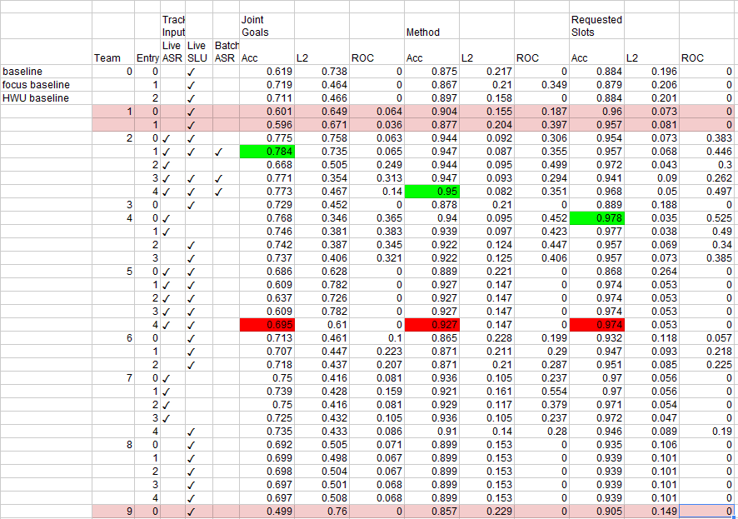
Results:9 teams with 31 submission

Slide 13
Conclusion & Discussion
It’s good on “request” (rank 2)
It’s average on “method” (rank 4)
It’s bad on “goals” (rank 7)
Weakness
Assume the goals are independent
Overfitting when data size is small
No history feature (future work)

Slide 14
Accumulated forward annotation
System: What kind of food would you like?
User: Does not matter -> “food=dontcare”
ASR: the phone number
Case 1: Do you like Chinese food?
User1: no -> “food=dontcare”
Case 2: What kind of food would you like?
User2: any type -> “food=dontcare”
ASR: any type

Slide 15
Missing Gold-standard
Assumptions: the SLU is correct if and only if:
it matches the differences between the pervious correct answer and the current one

